Slide 1


CineMatch: A Webpage for Personalized Movie Discovery and Recommendation Platform
CSA4315- INTERNET PROGRAMMING
Presented by:
Dhanashree S -192325082
Thanuja R-192325004
Charani.A-192319053
Guided by :-
Dr. Krishnaraj Mony
Associate Professor/CSE

Slide 2
INTRODUCTION
The proposed system develops a personalized movie recommendation system to provide movies according to individual user preferences.
The system analyzes user interactions such as movie ratings, viewing history, genres, likes, dislikes, and watch frequency.
Unlike traditional recommendation methods, the RL-based system learns continuously from user feedback and improves future recommendations.
A state represents the user's current preferences and viewing behavior, while actions represent the movies or movie categories recommended by the system.

Slide 3
Objectives
To develop a personalized movie recommendation system
To analyze user preferences based on ratings, watch history, genres, likes, and dislikes.
To learn the user's changing interests through continuous interaction and feedback.
To recommend relevant movies that match the individual user's preferences.
To balance exploration and exploitation to discover new movies while recommending preferred ones.

Slide 4
Problem Statement
Traditional movie recommendation systems often provide generic recommendations based on popularity or basic similarity.
They may fail to understand the changing preferences and interests of individual users.
Users can receive irrelevant or repetitive movie suggestions, reducing satisfaction and engagement.
Most conventional systems do not effectively learn from continuous user feedback, such as likes, dislikes, ratings, and skipped movies.

Slide 5
Existing System
Traditional movie platforms display movies based on popularity, ratings, or trending lists.
Users must manually search and browse through a large number of movies.
Recommendations are often generic and may not match individual interests.
Limited personalization based on users’ favorite genres, actors, languages, or viewing history.
Users may spend more time finding a suitable movie because relevant recommendations are limited.

Slide 6
Proposed System
CineMatch provides personalized movie recommendations based on users’ interests and preferences.
Uses recommendation algorithms to suggest movies according to favorite genres, actors, ratings, and viewing history.
Provides an easy-to-use interface for searching, filtering, and discovering movies.
Displays movie details, ratings, genres, descriptions, and recommendations.
Improves the movie discovery experience by offering relevant suggestions and reducing search time.

Slide 7
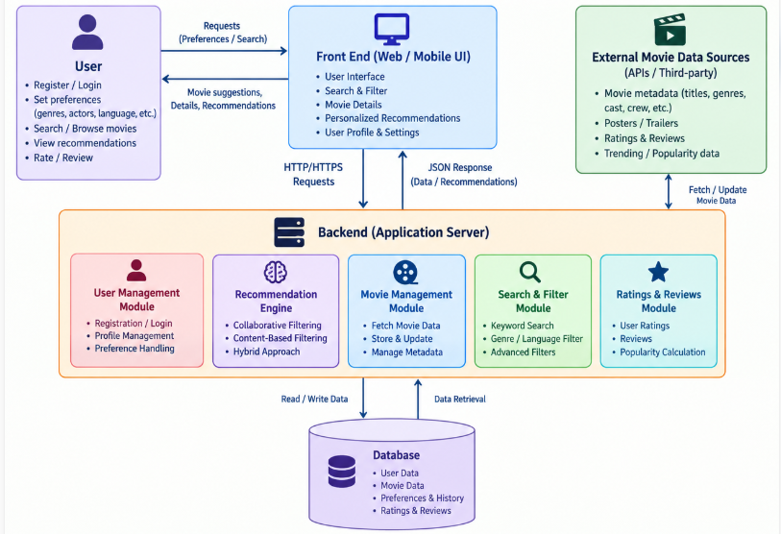
Architecture Diagram

Slide 8
Conclusion
The Personalized Movie Recommendation System provides intelligent and user-specific movie suggestions.
The system learns user preferences from ratings, watch history, likes, dislikes, and interactions.
It enables the system to continuously learn from user feedback and improve recommendations.
The exploration–exploitation strategy helps discover new movies while maintaining relevant recommendations.

Slide 9
References
Sutton, R. S., & Barto, A. G. (2022). Reinforcement Learning: An Introduction (2nd ed.). MIT Press.
Ricci, F., Rokach, L., & Shapira, B. (2021). Recommender Systems Handbook. Springer.
Koren, Y., Bell, R., & Volinsky, C. (2022). Matrix factorization techniques for recommender systems. Computer, 42(8), 30–37.
Schafer, J. B., Konstan, J., & Riedl, J. (2023). E-commerce recommendation applications. Data Mining and Knowledge Discovery, 5, 115–153.
Chen, X., et al. (2024). Personalized recommendation with deep reinforcement learning. Proceedings of the 2018 International Conference on Data Mining.

Slide 10
Thank You!

